Slide 1
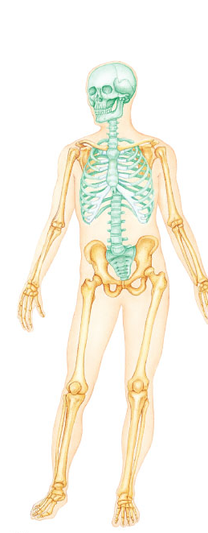
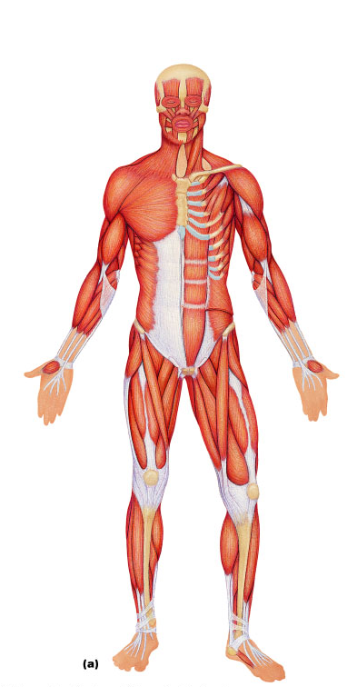
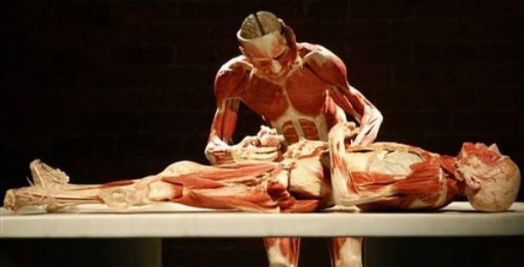
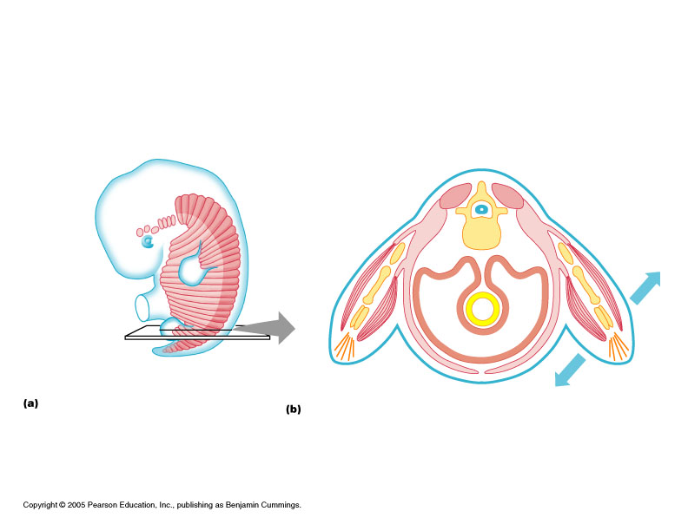
INTRODUCTION
TO
HUMAN ANATOMY
(a)

Slide 2
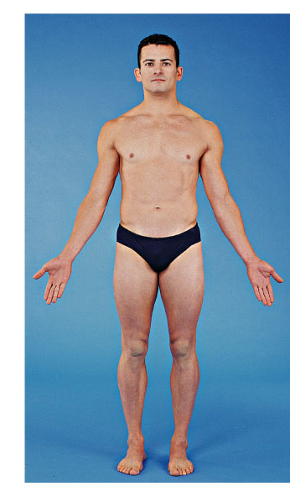
Gross Anatomy
  The anatomical position
  Directional and regional terms
  Body planes and sections
    1.Anterior
    2.Posterior
    3.Superior
    4.Inferior
    5.Medial
    6.Lateral
    7.Proximal
    8.Distal
    9.Superficial
    10.Deep
    11.Cephalic
    12.Vertebral
    13.Thoracic
    14.Appendicular
    15.Brachial
    16.Lumbar
  Anatomical position

Slide 3
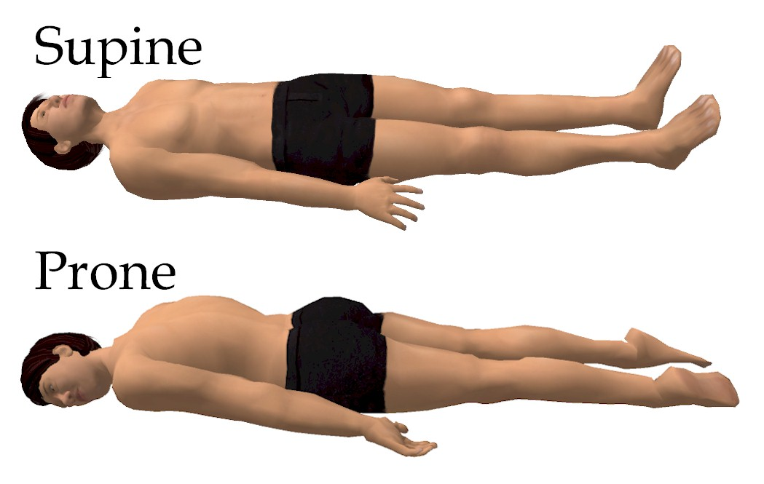

  Supine & Prone position

Slide 4
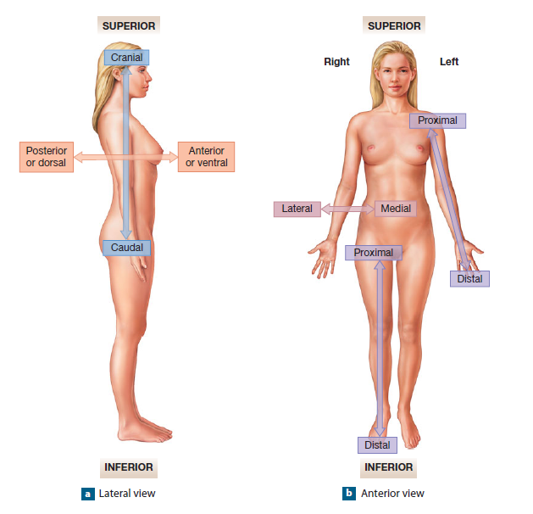
  Directional and regional terms

Slide 5
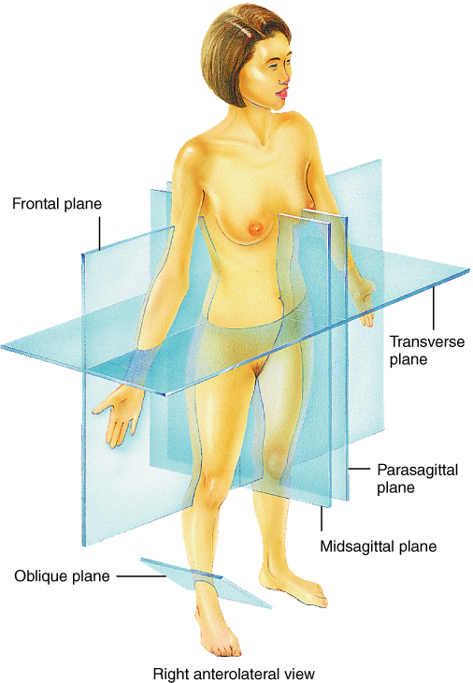
Body planes and sections
- cut into sections along a flat surface called a plane.

Slide 6
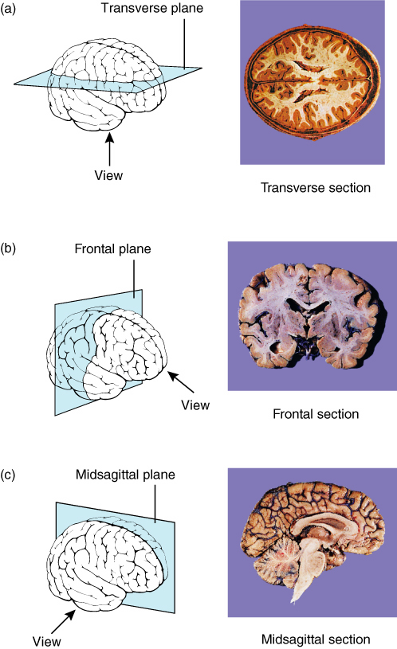

Slide 7
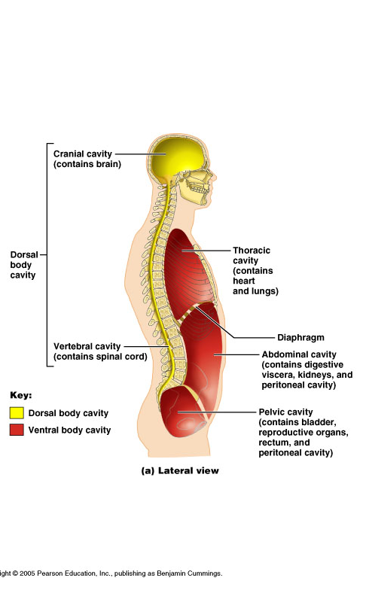
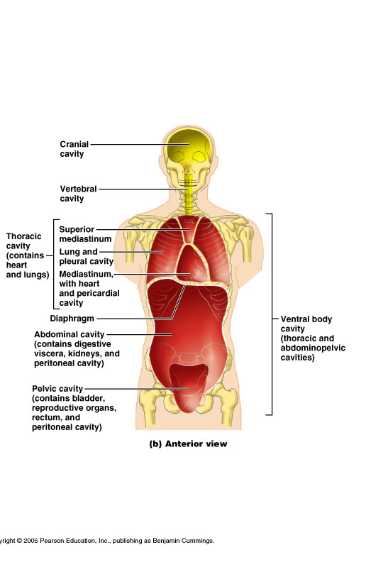

Slide 8
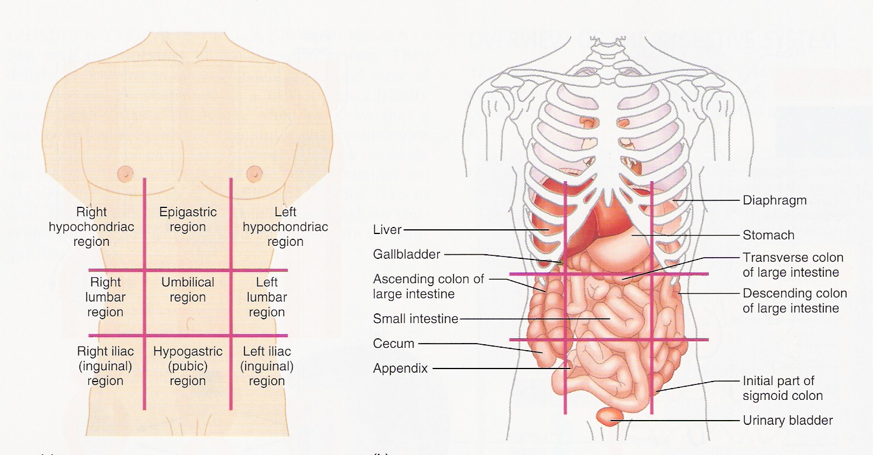
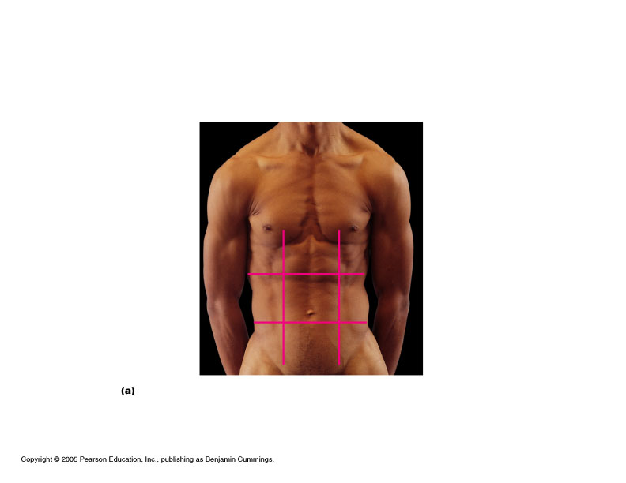
ABDOMINAL REGIONS AND QUADRANTS
9 abdominal regions; 4 quadrants
The important regions:
The 4 quadrants:
RUQ
LUQ
RLQ
LLQ
epigastric
flank
(side but
in back)
umbilical
inguinal,
(or iliac)

Slide 9
Terms used in Anatomy
Anterior/Ventral
Posterior/Dorsal
  Superior/Cranial
  Inferior/Caudal
  Medial
  Lateral
  Proximal
  Distal
  Superficial
  Deep
  Ipsilateral
  Contralateral
  Invagination
  Evagination
  Appendicular
  Axial
  Flexor
  Extensor

Slide 10












Terms related to body Movements
Flexion
Extension
Abduction
Adduction
Opposition
Circumduction
Medial rotation
Lateral rotation
Supination
Pronation
Dorsiflexon
Planterflexon
Inversion
Eversion
Protraction
Retraction
Flexion/Extension
Protraction/Retraction
Rotation
Adduction/abduction
Dorsi Felxion/ plantar lexion
Medial/Lateral
Inversion/Eversion
Adduction/abduction
Circumduction
Opposition
Elevation/Depression
Pronation/Supination

Slide 11
Organ systems
Integumentary
Skeletal
Muscular
Nervous
Endocrine
Cardiovascular
Lymphatic/immune
Respiratory
Digestive
Urinary
Reproductive

Slide 12
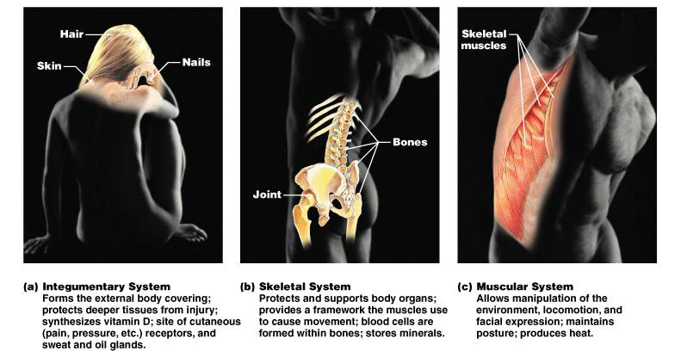

Slide 13
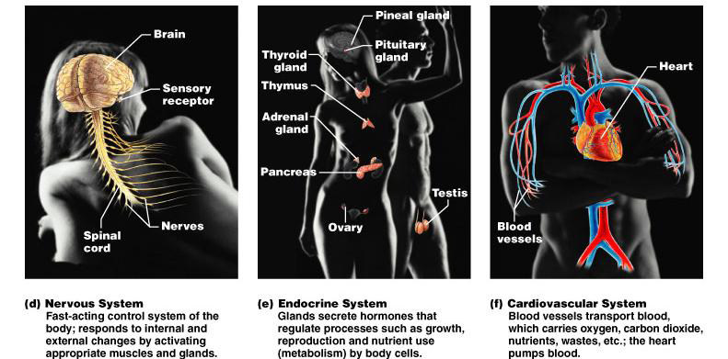

Slide 14
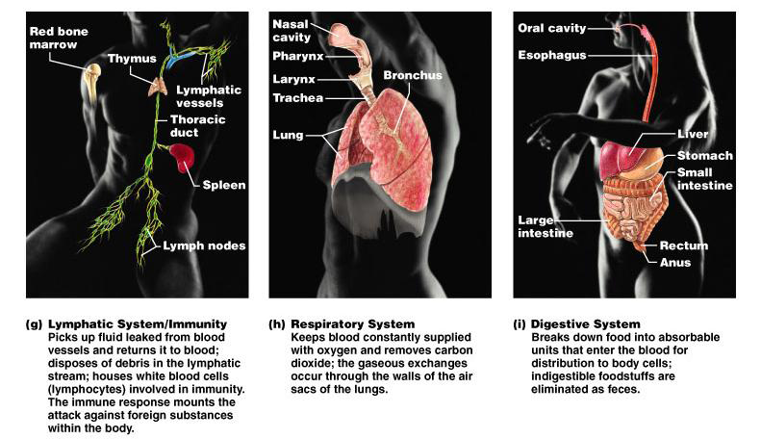

Slide 15
